Slide 1
NeuroMANCER Neural Modules with Adaptive Nonlinear Constraints and Efficient Regularizations
Madelyn Shapiro, Ján Drgoňa
Aaron Tuor, Rahul Birmiwal, James Koch, Draguna Vrabie

Slide 2

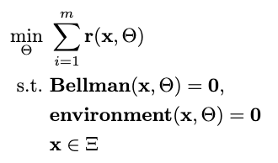

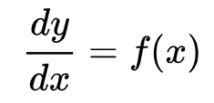

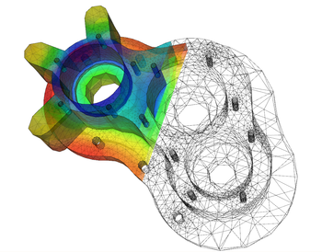
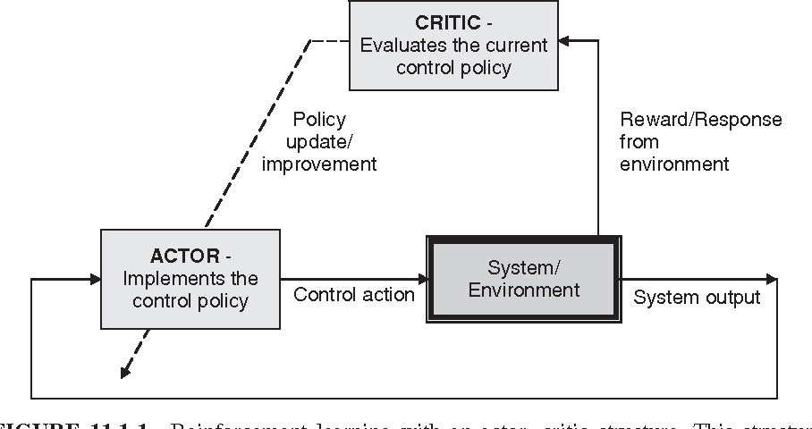

Landscape of Solution Methods
Constrained Optimization
Differential Equations
Supervised Learning
Reinforcement Learning
Requires prior knowledge of objective function and constraints
Requires prior knowledge of the physics to be modeled
Requires large labeled datasets
Requires environment model to sample
More domain knowledge
Less domain knowledge

Slide 3
















Landscape of Solution Tools
Constrained Optimization
Differential Equations
Supervised Learning
Reinforcement Learning
More domain knowledge
Less domain knowledge

Slide 4


What is NeuroMANCER?
Open-source scientific machine learning library for formulating and solving parametric constrained optimization problems, physics informed system identification, and parametric optimal control – leveraging PyTorch
Differentiable programming to integrate modern data driven modeling methods, deep learning tools and optimization modeling languages
Framework | data-driven | physics | constraints | dynamics | control
 | ✅ | ❌ | ❌ | ❌ | ❌
 | ✅ | ❌ | ❌ | ❌ | ✅
 | ❌ | ❌ | ✅ | ✅ | ✅
 | ❌ | ✅ | ✅ | ✅ | ✅
 | ❌ | ✅ | ✅ | ✅ | ✅
 | ❌ | ✅ | ✅ | ✅ | ✅
 | ❌ | ✅ | ✅ | ✅ | ❌
NeuroMANCER | ✅ | ✅ | ✅ | ✅ | ✅

Slide 5
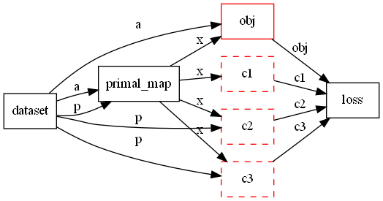
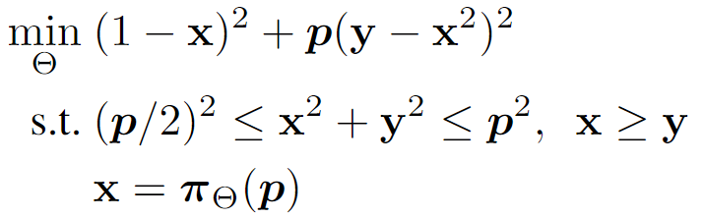
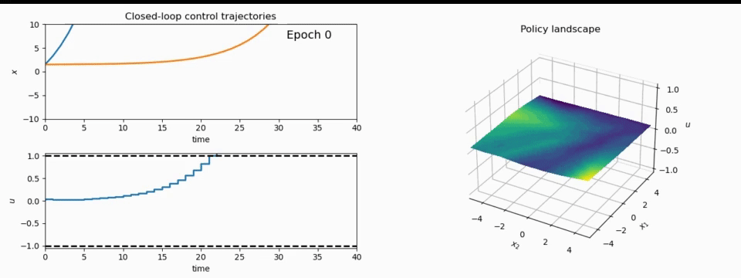
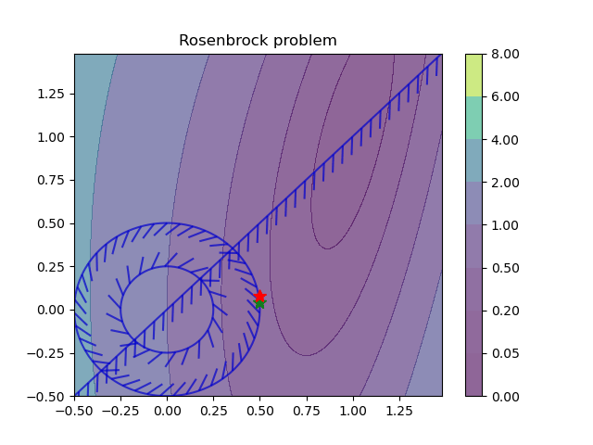
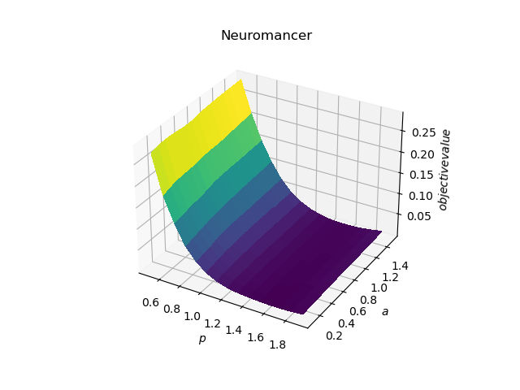
What is NeuroMANCER?
1. Mathematical formulation
3. Problem graph
map
2. Python code interface
4. Results
import neuromancer as nm
p = nm.variable(‘p’)
x = nm.variable(‘x’)
y = nm.variable('y’)
obj = ((1-x)**2 + p*(y-x**2)**2).minimize(weight=1.0, name='obj’) c1 = (p/2)**2 <= x**2 + y**2
c2 = x**2 + y**2 <= p**2
c3 = x >= y net = nm.MLP(insize=2, outsize=2, hsizes=[80]*4) map = nm.Node(net, input_keys=['p’], output_keys=[‘x’,‘y’])
loss = nm.PenaltyLoss([obj], [c1, c2, c3]) problem = nm.Problem([map], loss)
optimizer = torch.optim.AdamW(problem.parameters()) trainer = nm.Trainer(problem,data,optimizer)
best_model = trainer.train()

Slide 6
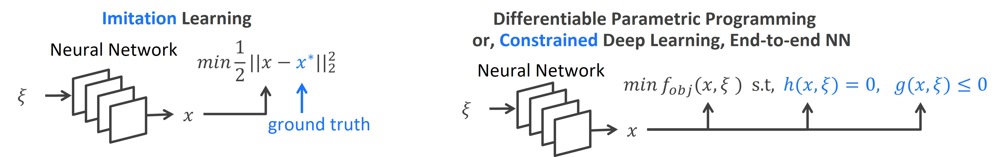
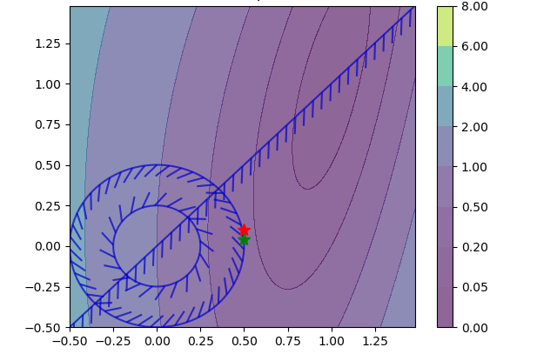
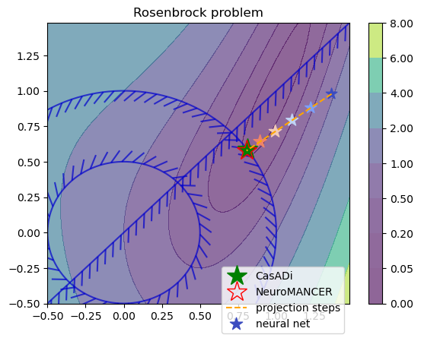
Learning to Optimize in NeuroMANCER
Training neural networks as explicit solutions
Feasibility restoration with implicit layers

Slide 7
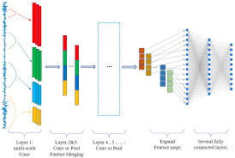
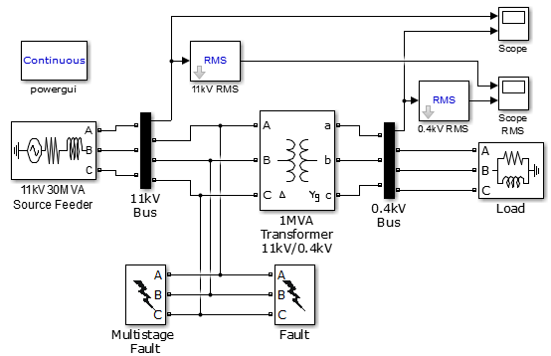
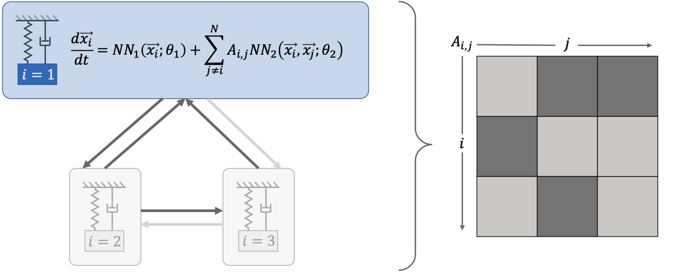
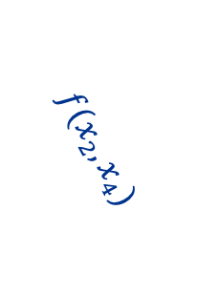
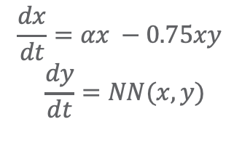

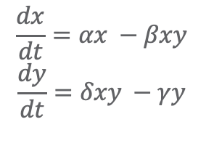
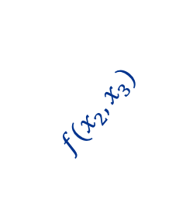
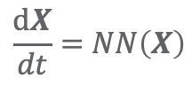
Landscape of Modeling Methods
White-box
Gray-box
Black Box
$$\frac{dx}{dt}=αx −βxy$$
$$\frac{dy}{dt}=δxy −γy$$
$$\frac{dx}{dt}=αx −0.75xy$$
$$\frac{dy}{dt}=NN(x,y)$$
$$\frac{dX}{dt}=NN\left(X\right)$$
More domain knowledge
Less domain knowledge
physics-based
networked neural ODEs
neural differential equations
state space models
physics priors
graph neural networks
3
$$f(x_{2},x_{3})$$
$$f(x_{2},x_{1})$$
1
2
$$f(x_{2},x_{4})$$
4

Slide 8
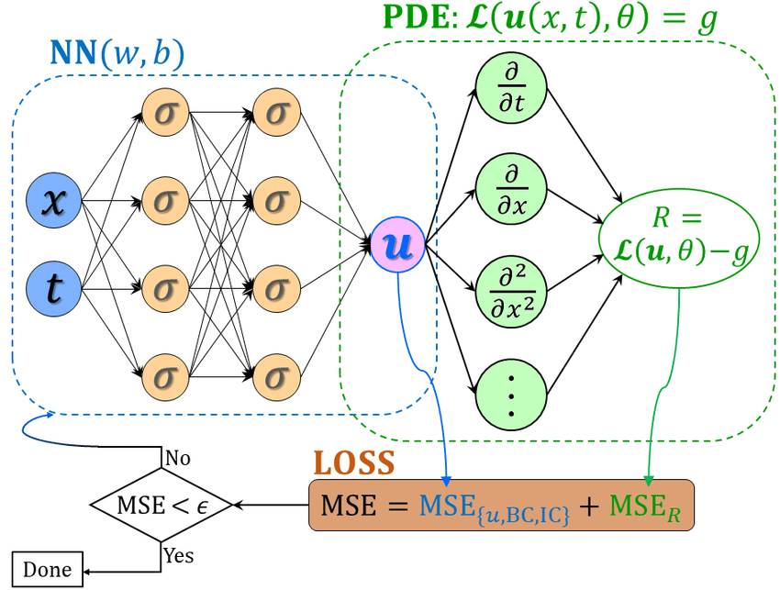
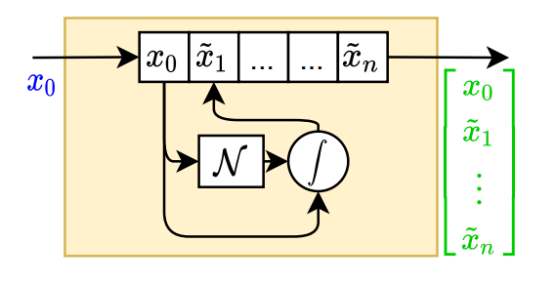
Data-driven Modeling Capabilities in Neuromancer
Component-based Physics-informed Machine Learning
Physics-Informed Neural Networks
Networked Dynamical systems
Neural differential equations

Slide 9
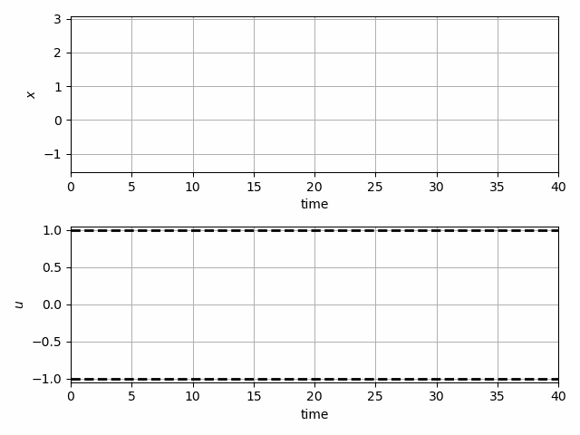
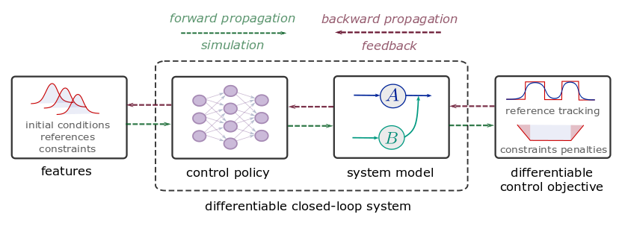
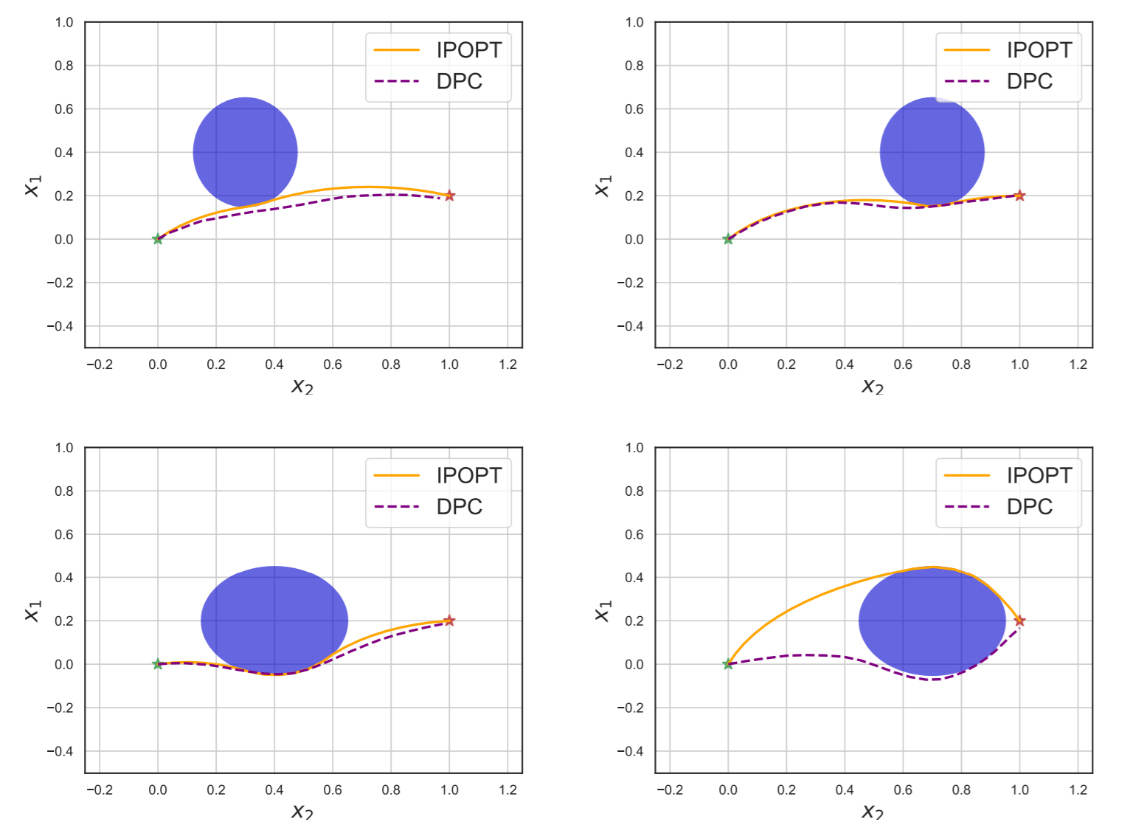
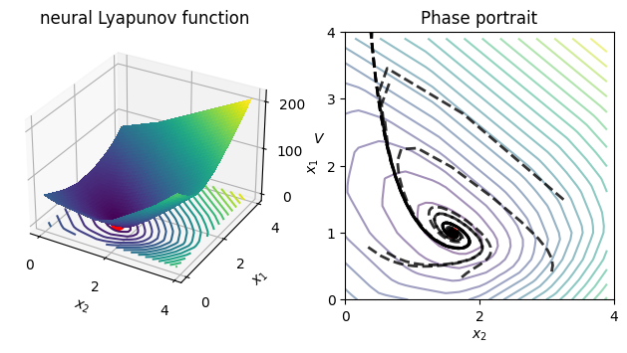
Optimal Control Capabilities in Neuromancer
Learning constrained model-based control policies with differentiable control methods
Learning stabilizing controllers
Trajectory optimization and obstacle avoidance
Learning Neural Lyapunov Functions

Slide 10



NeuroMANCER - Summary
Open-source scientific machine learning (SciML) toolbox in PyTorch for integrating deep learning, constrained optimization, and physics-based modeling
Physics-informed machine learning
Data-driven modeling of dynamical systems
Model-based policy optimization
Parametric constrained optimization
github.com/pnnl/neuromancer

